Slide 1





BUAN 6335 Group 5:
MeddGGenius Architecture Proposal
Steven Evans
Abhigna Alagoni
Muhammd Ayaz
Sampreethi Bokka
Monish Ravishankar
Daniel Li
Venkata Sai Charan Reddy Boojala

Slide 2




Problem Context
Outdated Legacy Infrastructure
Data Silos and Duplication
Inability to Handle Unstructured Data
Compliance and Security Risks
Operational Inefficiencies

Slide 3

Key Deliverables
Security and Compliance Framework
Seamless data integration pipelines
Advanced Analytics and ML Use Cases
A unified modern Data Platform Architecture
Cost-Efficiency and Scalability Roadmap

Slide 4




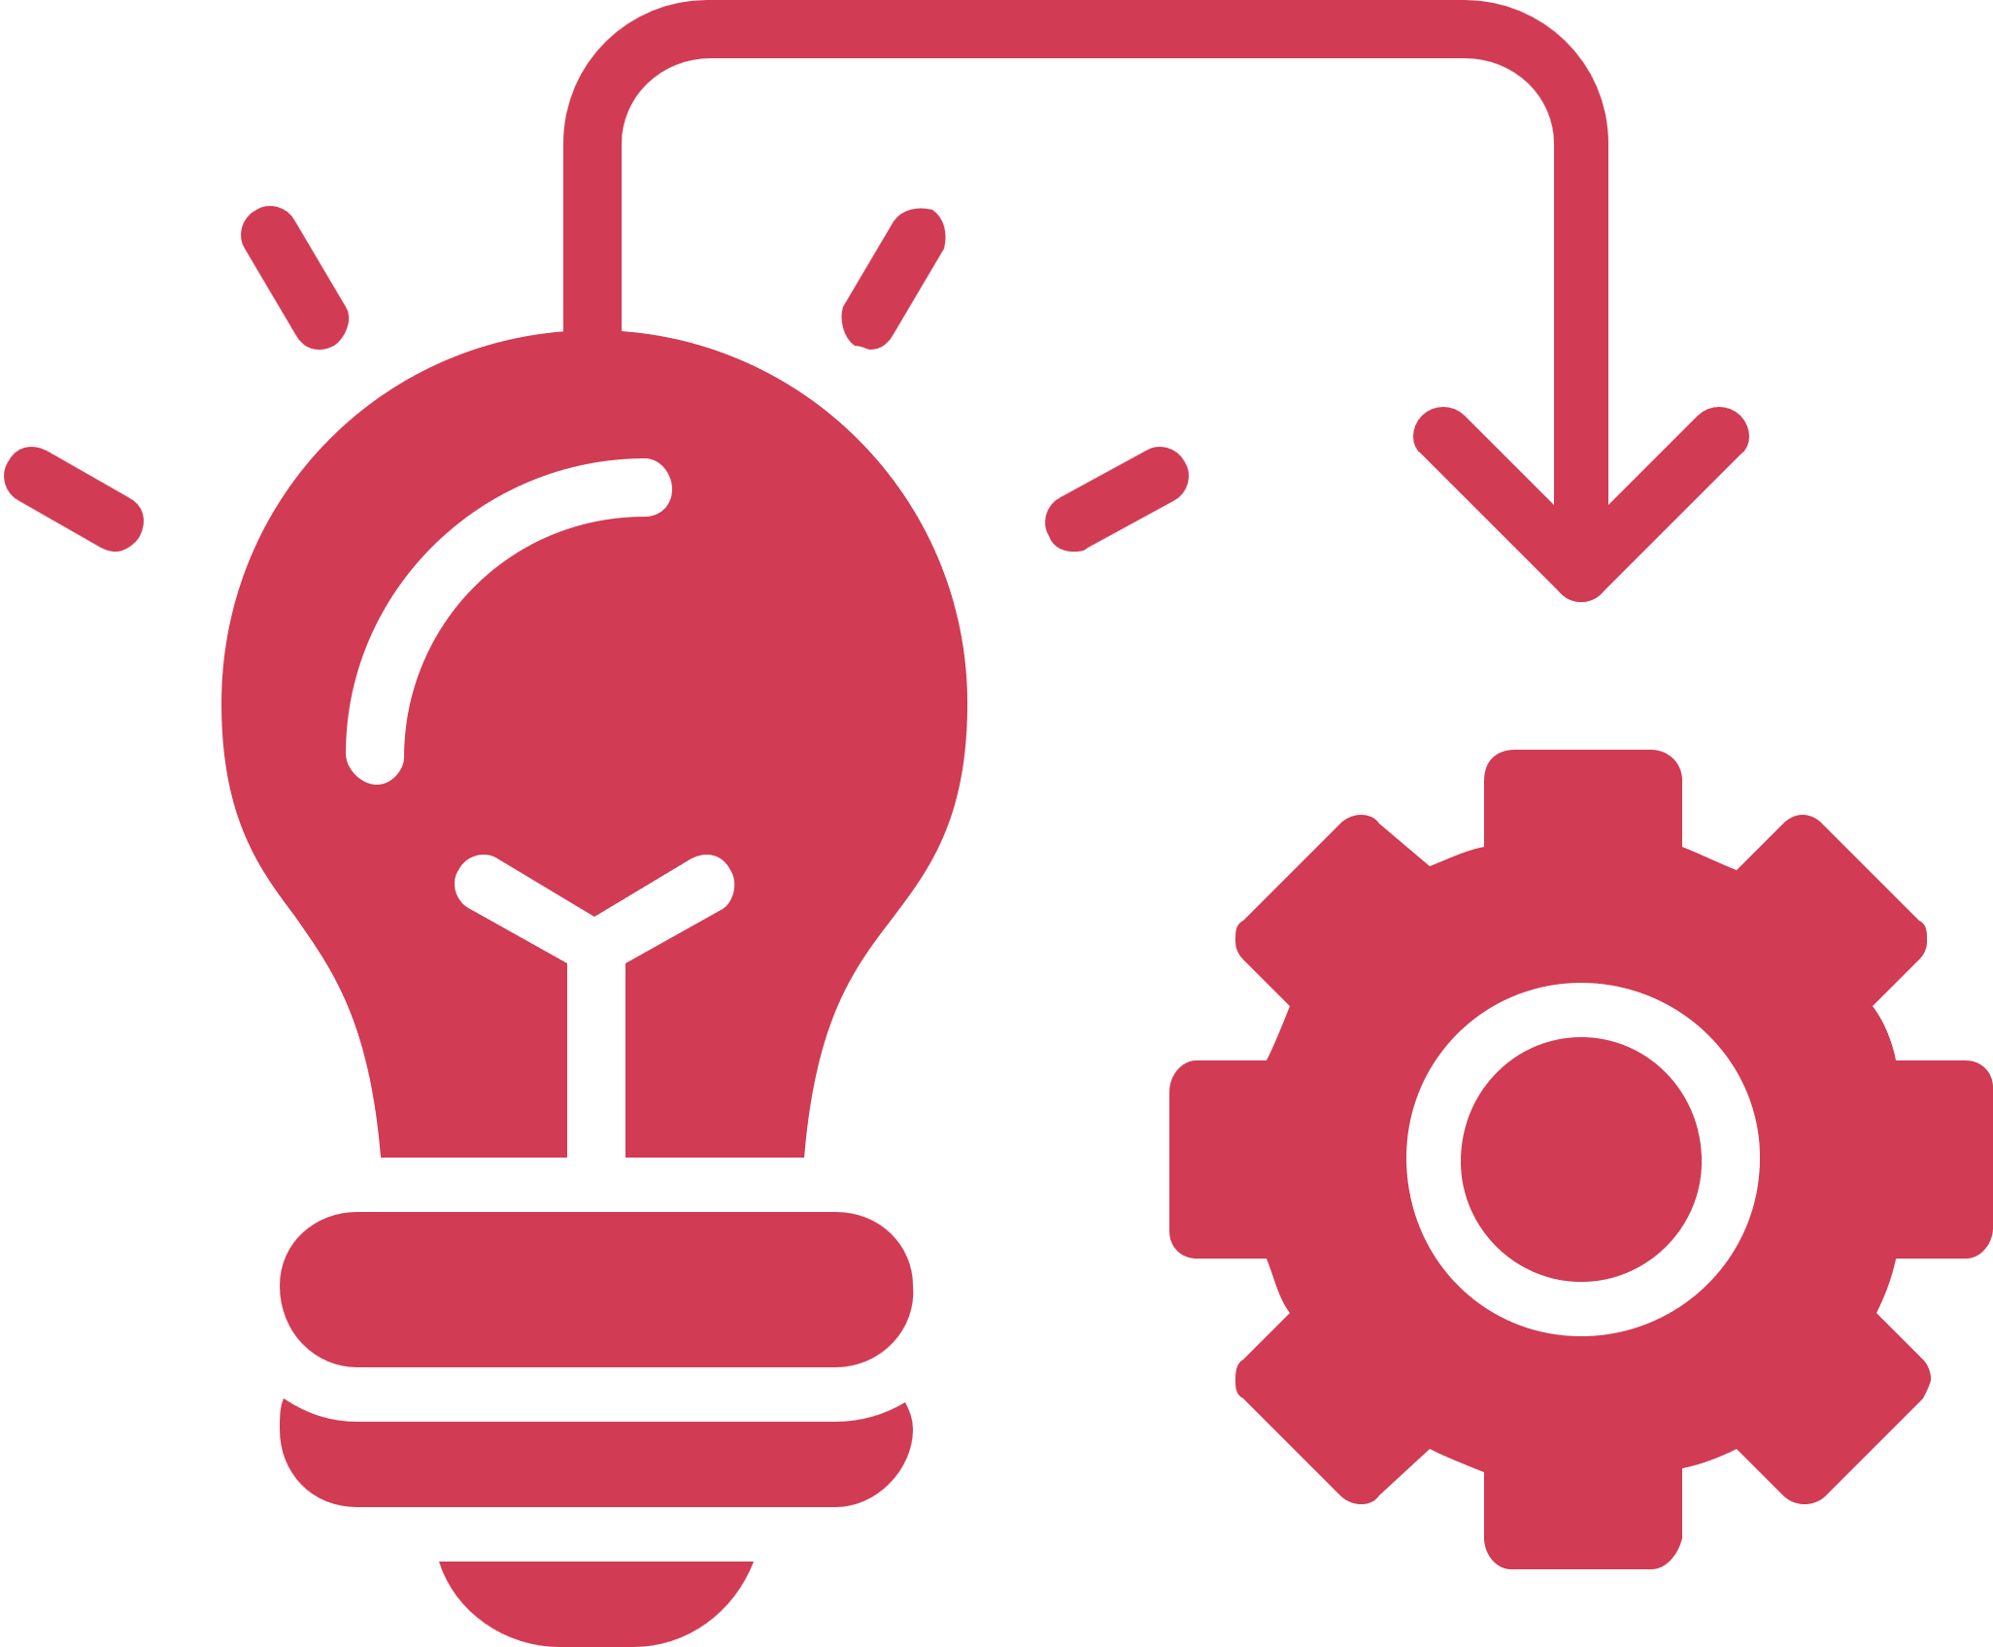

Our Choice Platform: AWS
Scalability & Versatility
AWS provides a scalable foundation with diverse tools for MedGGenius’ growing and complex needs.
Seamless Integration
Prioritizes stable, secure data streaming from patient sensors and in-house systems.
Implementation Quality
Focused on ease of use, regulatory compliance, and robust connections for end-to-end data flow.

Slide 5
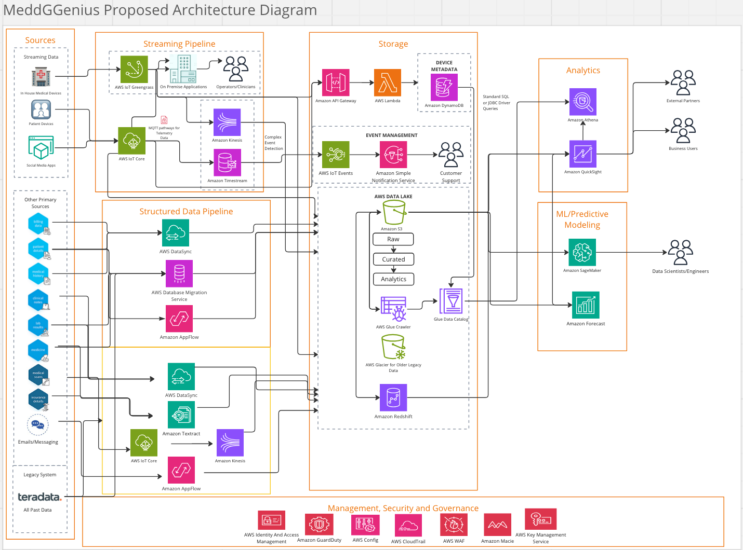

Slide 6
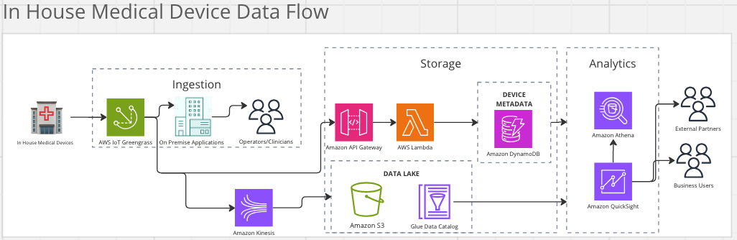
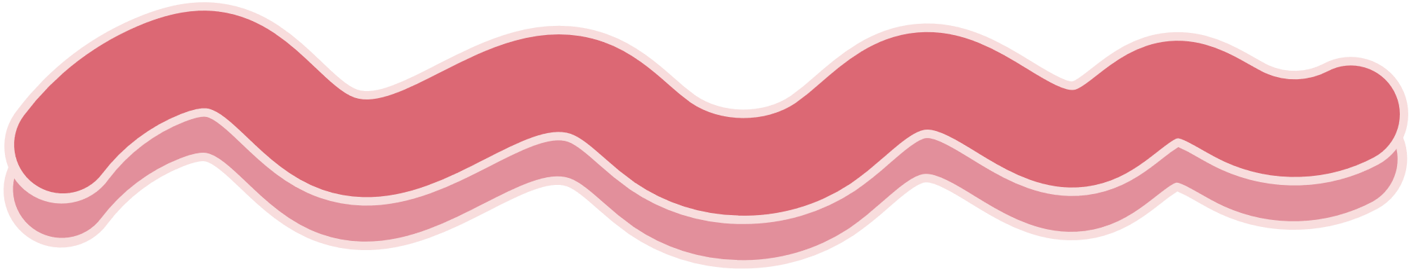
Streaming Pipeline
Pipeline Stages for In-House medical Devices:
Ingestion: AWS IoT Greengrass secures and processes data from firewalled in-house devices.
Preprocessing: Local Lambda functions and Docker containers handle preprocessing.
Storage: Full data in S3; metadata processed via API Gateway/Lambda to DynamoDB.
Downstream: Real-time delivery to on-prem apps, Kinesis for analytics, and ML.

Slide 7
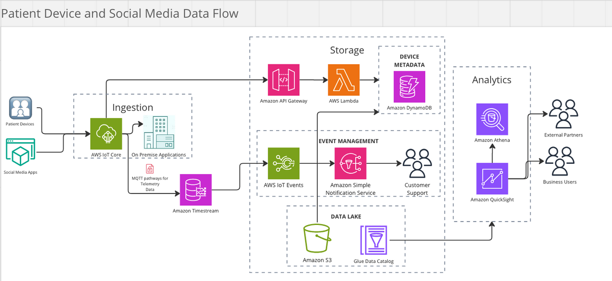
Streaming Pipeline
Pipeline Stages for Patient Devices and Social Media data:
Ingestion: AWS IoT Core collects telemetry data via MQTT for secure communication.
Event Detection: IoT Core, Timestream, and SNS detect and address sensor or device issues.
Storage: Data in S3 for analysis; metadata routed through API Gateway to DynamoDB.

Slide 8
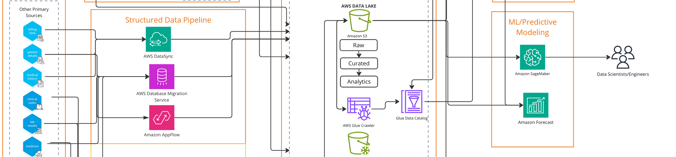
Structured Data Pipeline
Structured Data Pipeline Applications(Ingestion):
AWS DataSync: Automates the transfer of large structured data files (e.g., CSV files,patient records) from local servers systems to Amazon S3.
AWS Database Migration Service (DMS): Handles one-time and continuous replication of relational database schemas and data to Amazon Redshift.
Amazon AppFlow: Securely connects SaaS applications (e.g., Salesforce, ServiceNow) with AWS services like S3. It allows bidirectional data transfer between cloud applications and AWS without the need for custom code.

Slide 9
Structured Data Pipeline
Data Transformation: Uses AWS Glue Crawler to clean, transform, and prepare data for analytics by removing duplicates, standardizing formats, and organizing metadata.
Data Storage: Stores raw, curated, and analytics-ready data in Amazon S3 as a data lake and Amazon Redshift for advanced analytics.
Analytics: Provides insights with Amazon Athena for SQL-based querying, QuickSight for dashboards, and SageMaker for predictive modeling.
Governance and Compliance: Secures data using AWS Lake Formation for role-based access. Secure and monitor the pipeline while ensuring compliance with regulatory standards like HIPAA.

Slide 10
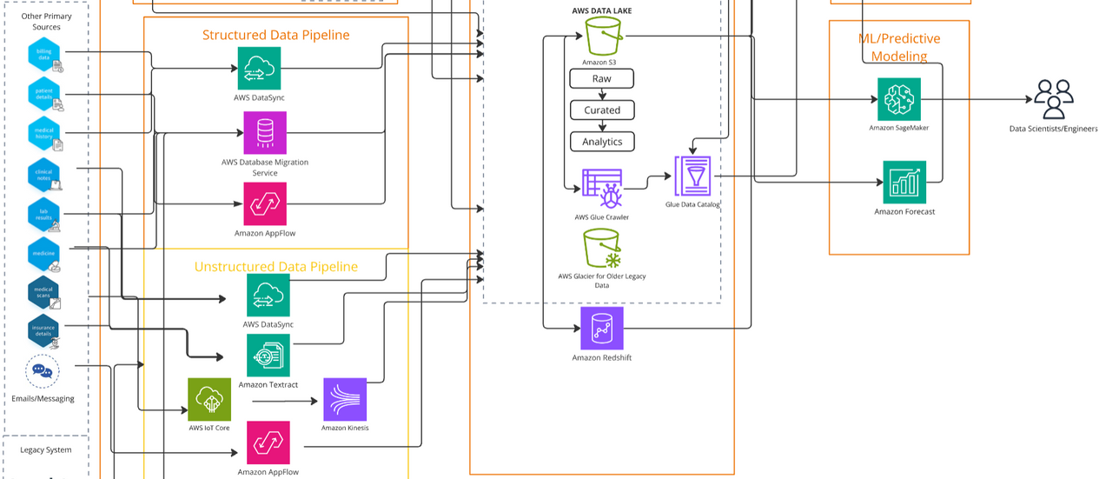
Unstructured Data Pipeline
Unstructured Data Pipeline Applications (Ingestion):
AWS DataSync: If stored in a file system (e.g., PDF, text files), after using AWS DataSync it transfers those files to Amazon S3.
Amazon Textract: Takes scanned documents, forms, handwritten prescriptions, or PDFs. Textract extracts structured data from unstructured documents.
AWS IoT Core and Amazon Kinesis: Devices send unstructured data and we route it to Amazon Kinesis for real-time streaming and analytics.
Amazon AppFlow: Allows direct integration with many external applications, ensuring seamless ingestion (e.g., email services like Microsoft Outlook, Gmail).

Slide 11
Unstructured Data Pipeline
Data Storage: Store raw, curated, and analytics-ready data in Amazon S3 and Redshift for running complex queries and ideal for analytics workloads.
Data Transformation: Glue Crawler catalogs metadata for all datasets. Glacier stores raw data that is rarely accessed, saving costs while ensuring compliance.
Analytics: Utilize Athena to run SQL queries directly on data stored in Amazon S3 and prepare data before visualization in BI tools like QuickSight to create dashboards and reports.
ML/Predictive Modeling: Use SageMaker for natural language processing, classification, regression, clustering, recommendation systems, and anomaly detection for unstructured data.
Governance and Compliance: Secure data using KMS for data at rest, Cloudtrail for audit activity, and Macie for sensitive data.

Slide 12







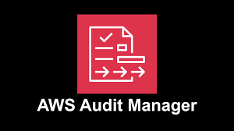


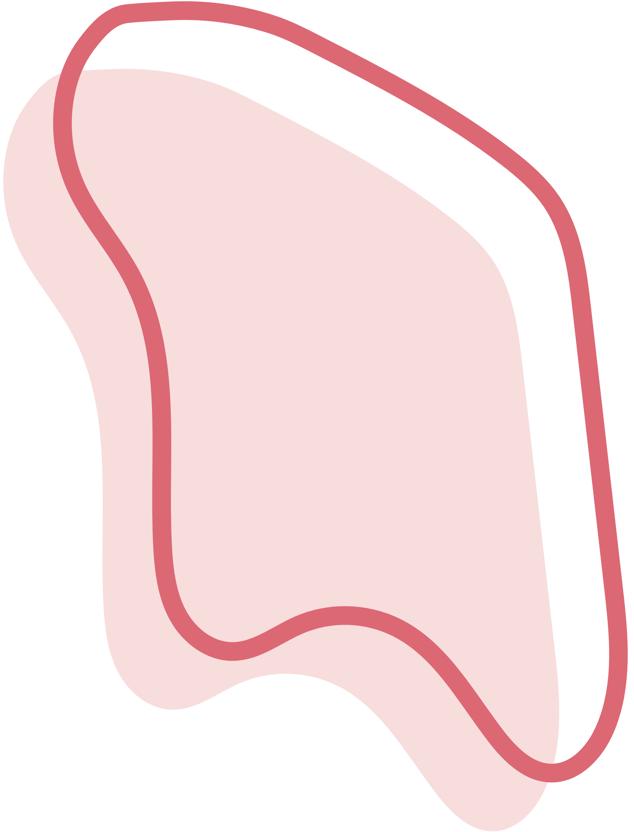


Management, Security and Governance
AWS Identity and Access Management
Amazon GuardDuty
AWS Config
AWS KMS
AWS WAF
Amazon Macie
AWS CloudTrail
Legacy Challenges
AWS Solutions
Cumbersome Manual Processes
Centralized, automated access control
Compliance complexity
Config Automates compliance and tracking
Struggles with Scalability
HIPAA gnd NIST compliance
Blind Spots in RealTime Monitoring
Continuous threat monitoring

Slide 13

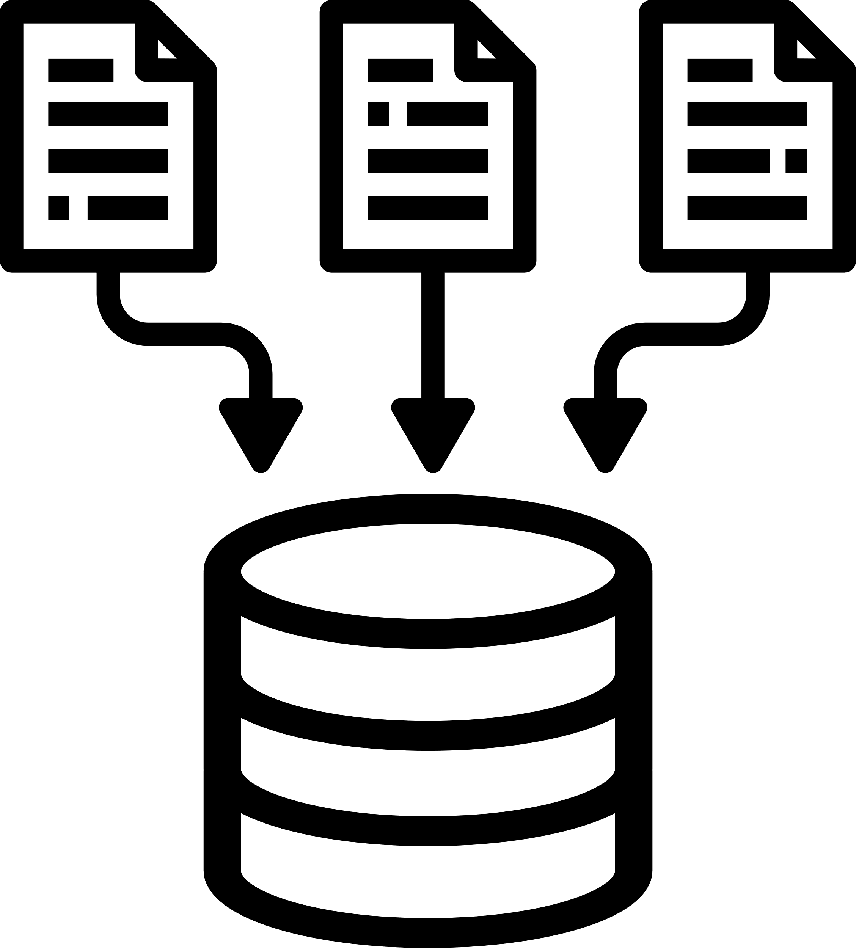


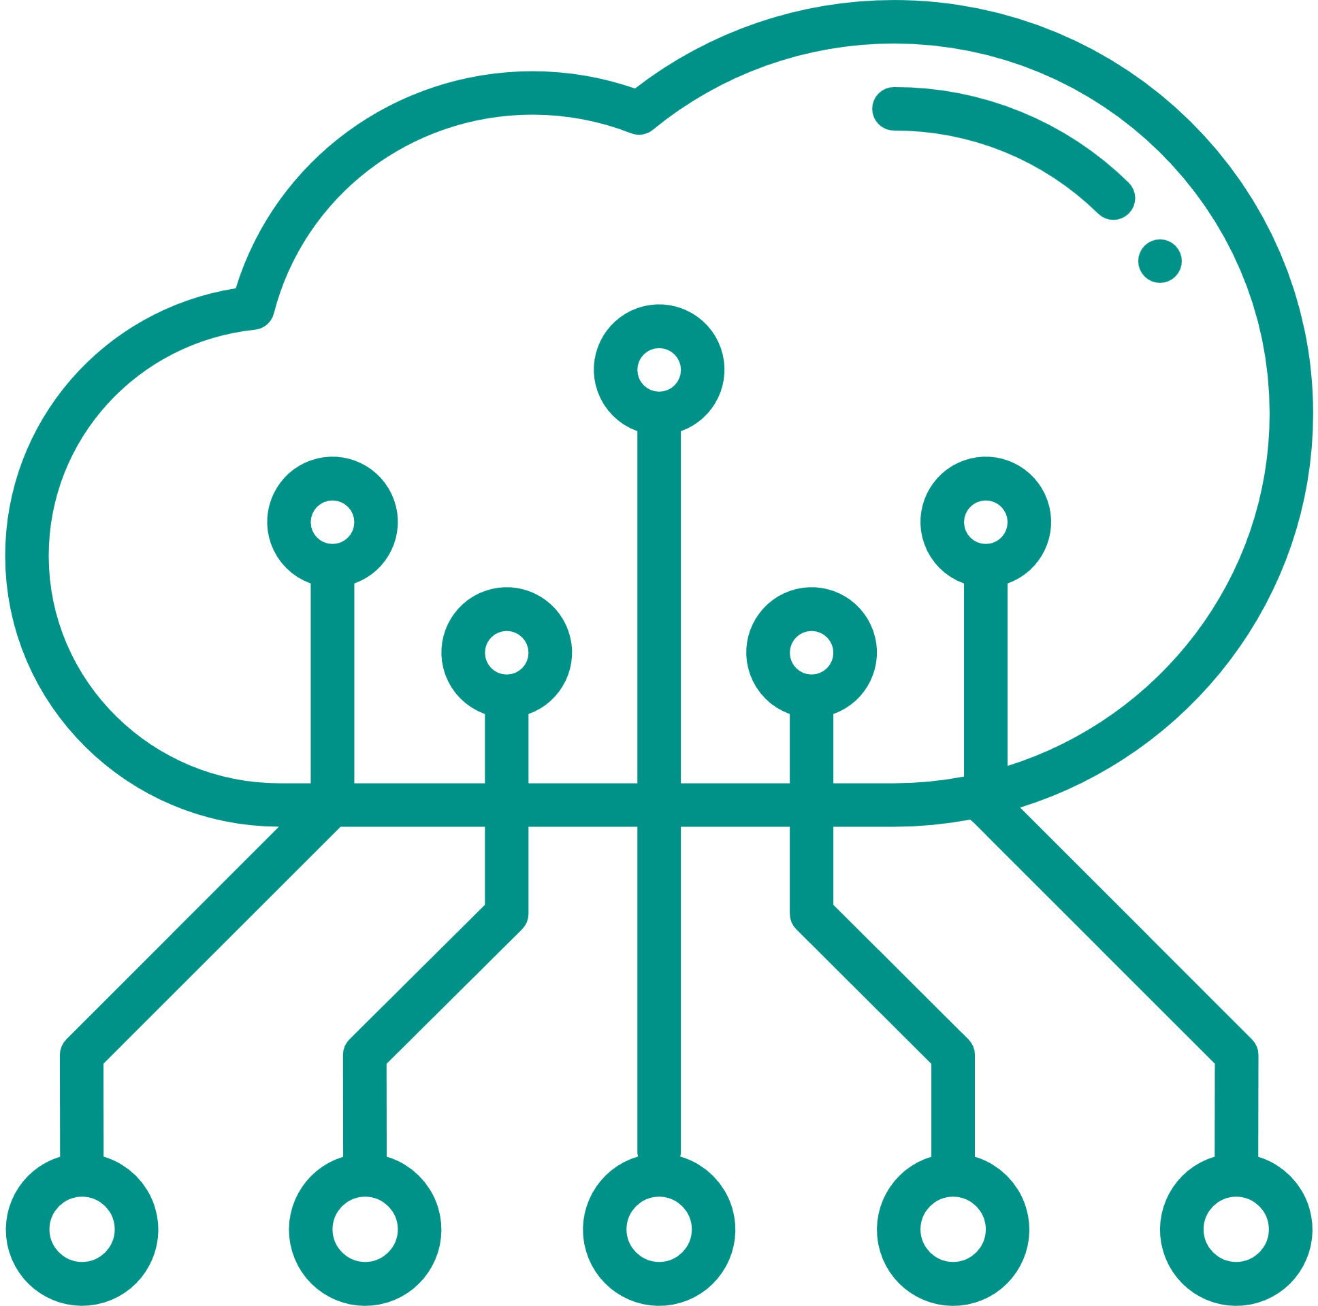

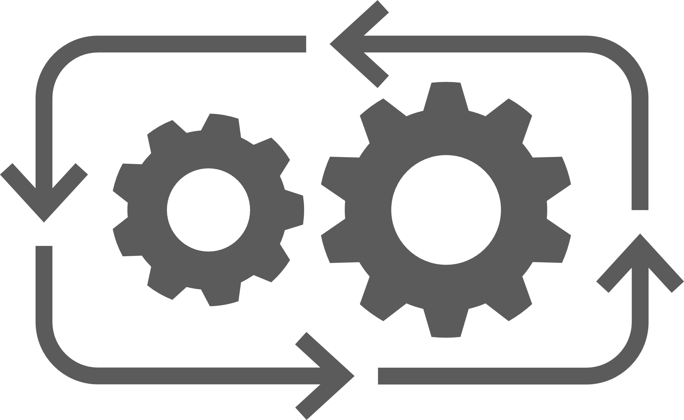
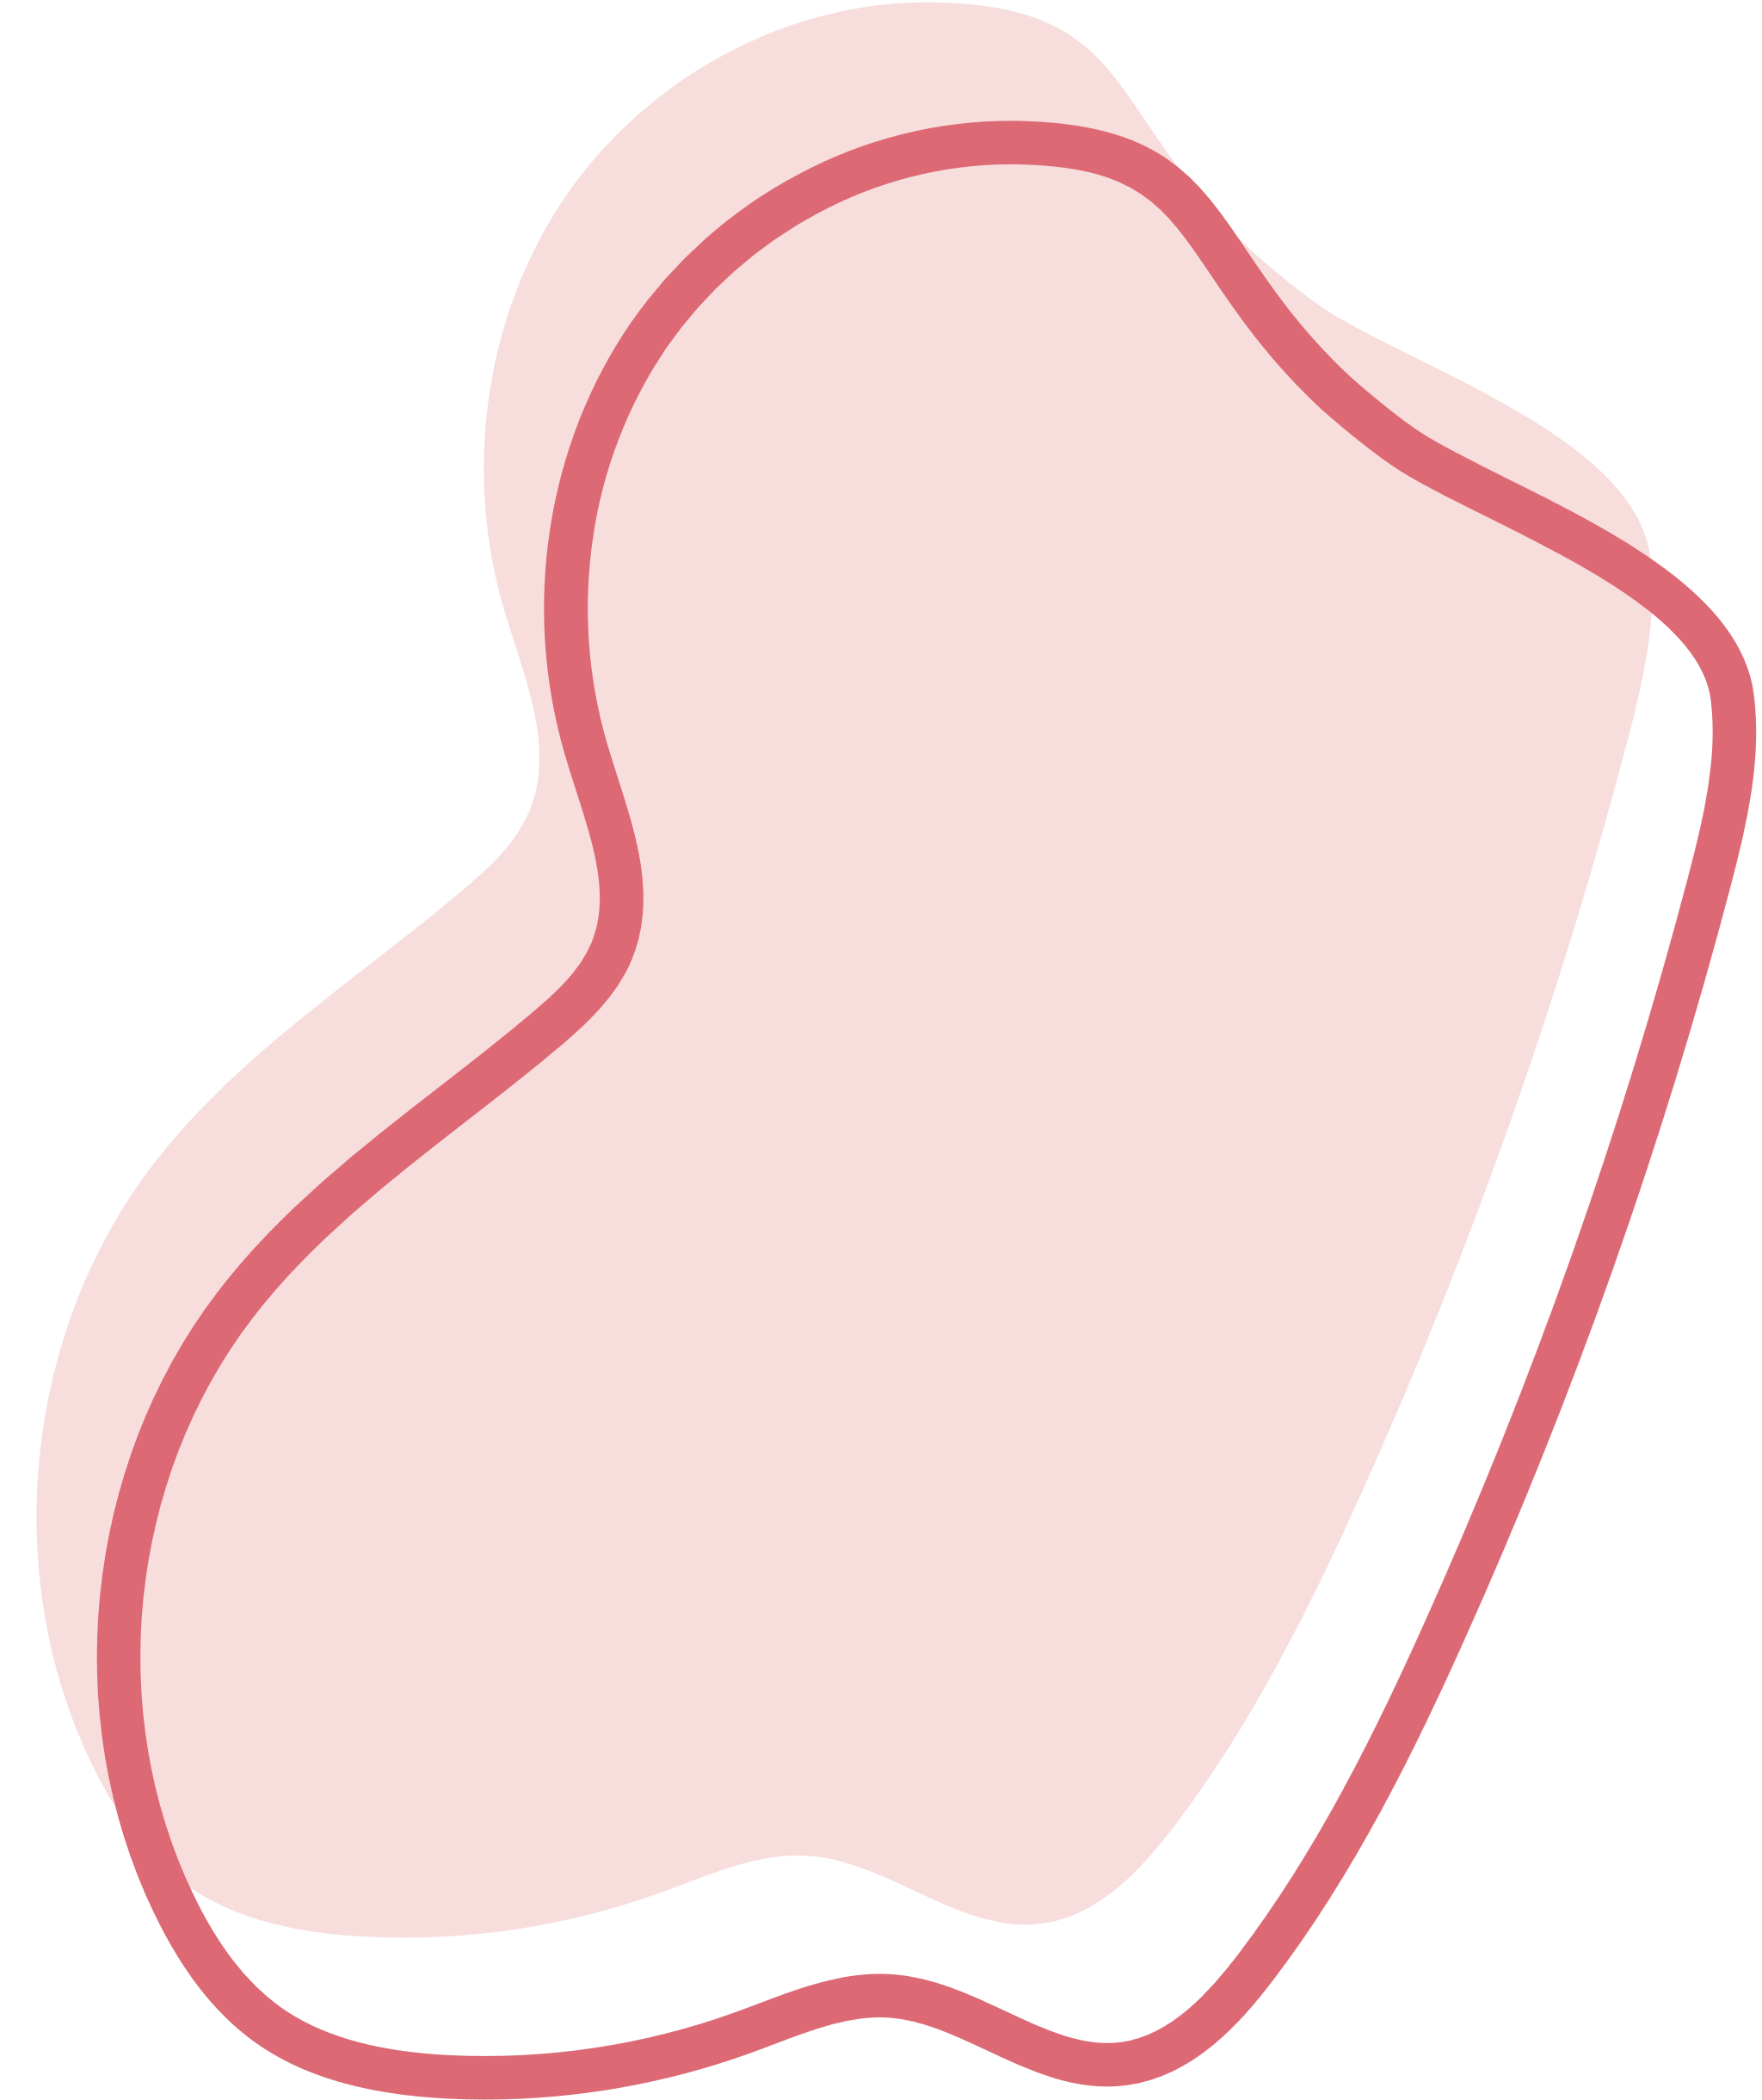
Advantages
Scalable and adaptable for growth
Real-time processing
Unified data platform
Advanced analytics and ML capabilities
compliance and security features
Automation

Slide 14




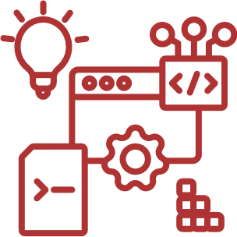
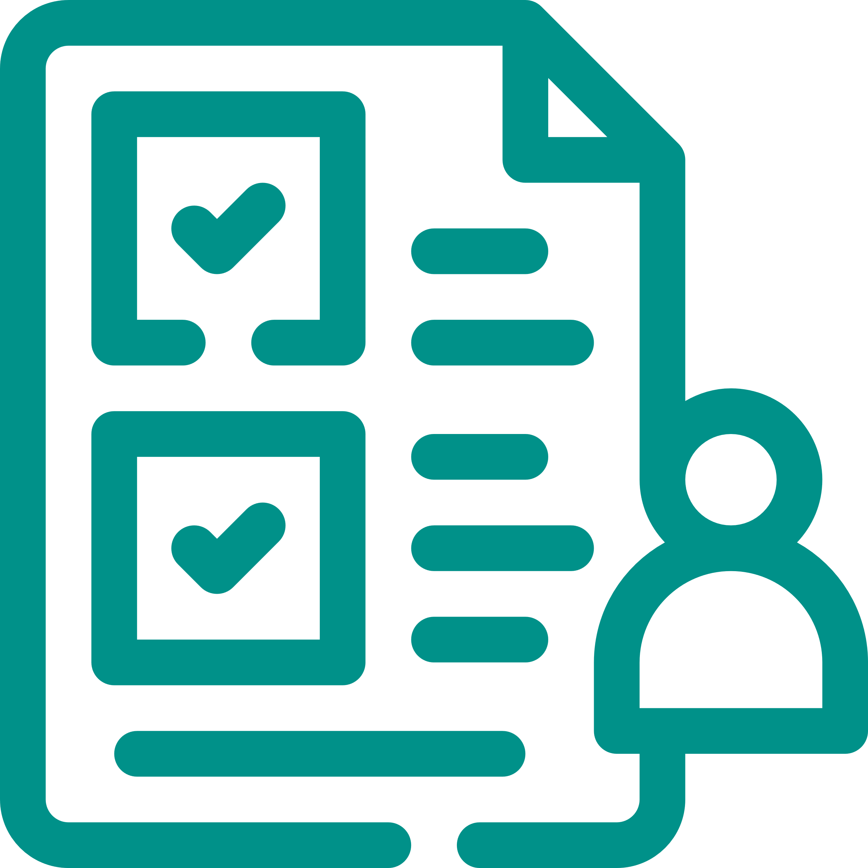
Challenges
High costs
Complexity
Latency issues for large queries
Data Integrity Challenges
Complexity in maintaining compliance

Slide 15







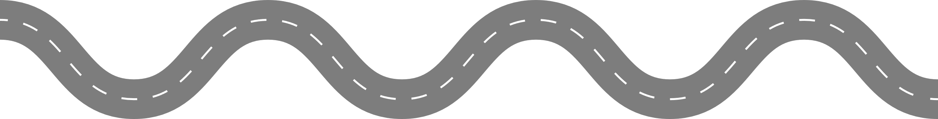









ROADMAP FOR IMPLEMENTATION
1.5 Months
3-5 Months
3 Months
Vision Alignment and Strategic Planning
Infrastructure Development and Data Migration
Analytics and Predictive Modeling Enablement
Architectural Design & Blueprinting
Deployment, Monitoring, and Training
Continuous Improvement and Scalability
3 Months
2.5 Months
Ongoing

Slide 16



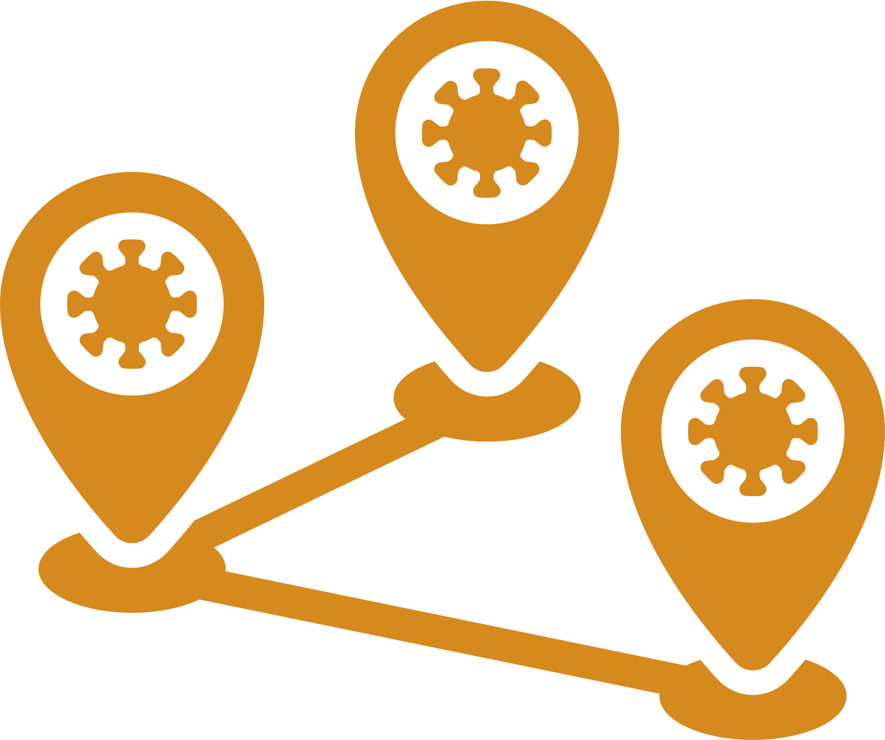

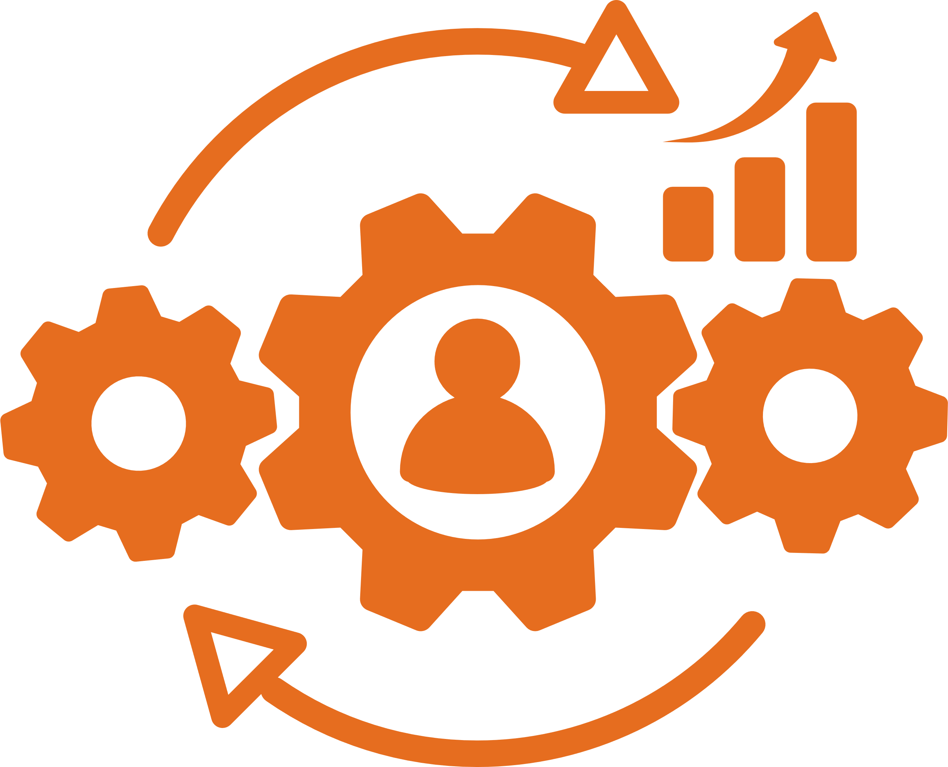
ML Use Cases
Staff Scheduling optimization
Medical Imaging analysis
Disease outbreak prediction
Surgical outcome prediction
Operational Shortage Detection

Slide 17


Thankyou!

Slide 18
References
FDA - Medical Device Cybersecurity: U.S. Food and Drug Administration. (2021). Medical device cybersecurity: What you need to know. Retrieved from https://www.fda.gov/consumers/consumer-updates/medical-device-cybersecurity-what-you-need-know
AWS - IoT Medical Devices: Amazon Web Services. (n.d.). AWS architecture for medical devices. Retrieved from https://d1.awsstatic.com/architecture-diagrams/ArchitectureDiagrams/iot-medical-devices-ra.pdf?did=wp_card&trk=wp_card
Keyfactor - Public Key Infrastructure (PKI): Keyfactor. (n.d.). What is PKI? Retrieved from https://www.keyfactor.com/education-center/what-is-pki/#:~:text=practice%20PKI%20programs.-,What%20are%20Common%20Challenges%20that%20PKI%20Solves?,Email%20and%20data%20encryption
AWS - Streams Introduction: Amazon Web Services. (n.d.). Introduction to Amazon Kinesis Data Streams. Retrieved from https://docs.aws.amazon.com/streams/latest/dev/introduction.html#:~:text=Accelerated%20log%20and%20data%20feed,Streams%20applications%20and%20data%20streams.
AWS - Using Athena and Quicksight: Amazon Web Services. (2021). Use Amazon Athena and Amazon QuickSight in a cross-account environment. Retrieved from https://aws.amazon.com/blogs/big-data/use-amazon-athena-and-amazon-quicksight-in-a-cross-account-environment/
IoT For All. (n.d.). How IoT devices transform healthcare with real-time data collection. Retrieved from https://www.iotforall.com
MDPI. (2023). Lack of connectivity and disruptions in IoT health devices. MDPI Journal of Diagnostics, 14(18), 2037. Retrieved from https://www.mdpi.com
American Medical Association. (n.d.). 4 mistakes your patients should avoid with wearables. AMA Insights. Retrieved from https://www.ama-assn.org
Therapeutic Goods Administration (TGA). (2022). Actual and potential harm caused by medical software. TGA Report. Retrieved from https://www.tga.gov.au
Cleio Insights. (n.d.). Wearable medical devices: Challenges in design. Retrieved from https://cleio.com

